Slide 1
PRESPEC & The (Time-Dependent) Mean Field
Dr Paul D Stevenson
University of Surrey

Slide 2
PRESPEC Topics
1) Isomer and metastable decays and associated nuclear structure tests, including shell model configurations around magic numbers, seniority and core excitation isomers.
2) Shell model physics around 56Ni, 100Sn, 132Sn and 208Pb.
3) Beta-delayed spectroscopy of heavy, neutron-rich isotopes associated with shape evolution.
4) 'Fast-timing' measurements of nuclear states using arrays of LaBr3 detectors.
5) Measurements of decay heat and beta-delayed neutron emission probability from fission fragments.
6) Limits of the nuclear chart by measured by proton radioactivity
7) Studies of isospin symmetry and mixing, and B(GT) strength measurements.
8) Beta-delayed neutron measurements of relevance to astrophysical scenarios
9) and others....

Slide 3
Theory convergence
No need to talk about “shell-model physics”
Effective shell model Hamiltonians from density functional theory: Quadrupolar and pairing correlations Author(s): Rodriguez-Guzman, R; Alhassid, Y; Bertsch, GFSource: PHYSICAL REVIEW C Volume: 77 Issue: 6 Article Number: 064308 Published: 2008
Configuration Interactions Constrained by Energy Density Functionals, B. Alex Brown, Angelo Signoracci, Morten Hjorth-Jensen, Journal-ref: Phys.Lett.B695:507-511,2011
The Negele-Vautherin density matrix expansion applied to the Gogny force, J. Dobaczewski, B.G. Carlsson, M. Kortelainen, J. Phys. G: Nucl. Part. Phys. 37 (2010) 075106
"The Long Journey from Ab Initio Calculations to Density Functional Theory for Nuclear Large Amplitude Collective Motion," A. Bulgac, J. Phys. G 37, 064006 (2010).

Slide 4
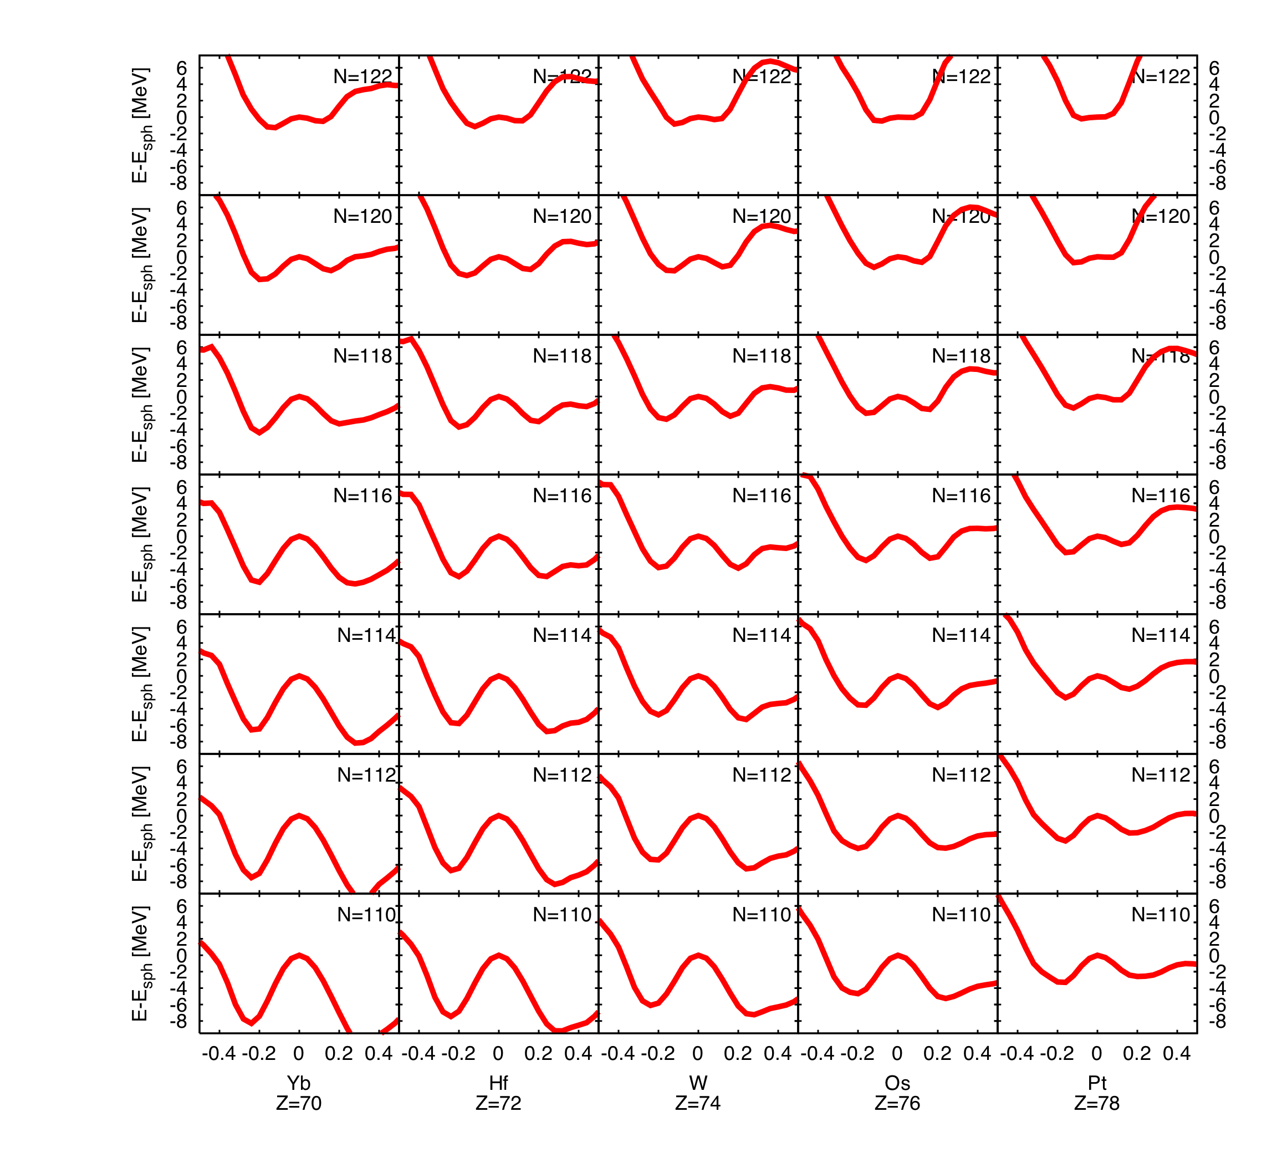
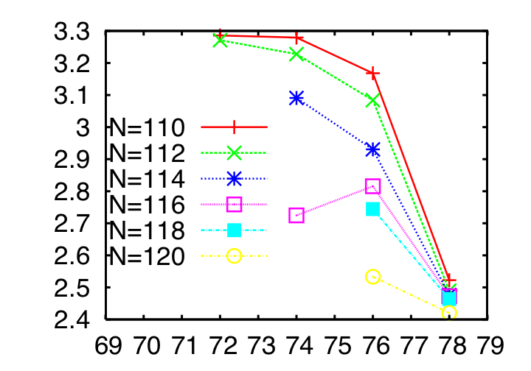
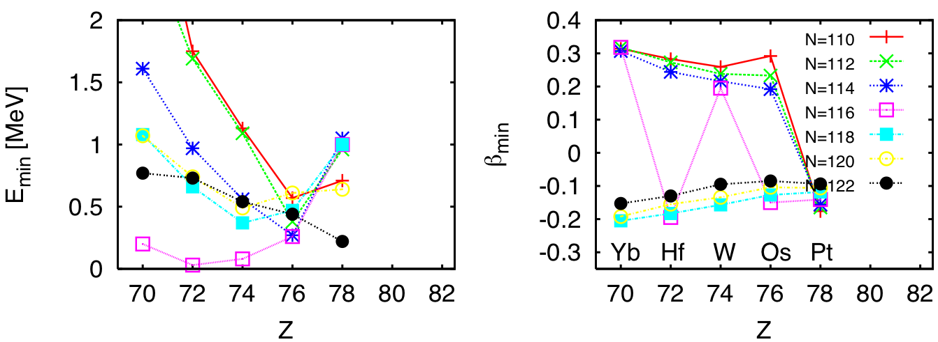
Shape evolution
Zs. Podolyak et al., Phys. Lett. B491, 225(2000)
P. D. Stevenson, M. P. Brine, Zs. Podolyák, P. H. Regan, P. M. Walker and J. Rikovska Stone, Phys. Rev. C 72, 047303 (2005)

Slide 5
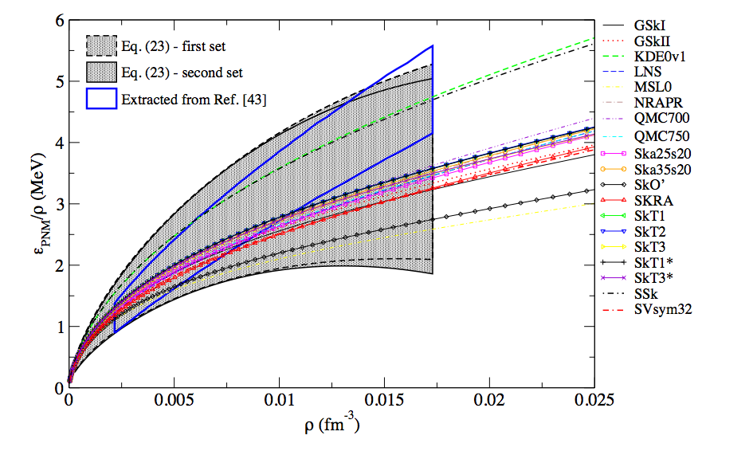
But for every observable…
There are lots of predictions
These for EoS of Pure Neutron Matter
M. Dutro et al, in preparation
Notes:
FIG. 3: (color on line) Constraint PNM1: Energy per particle for pure neutron matter as a function of density corresponding to the Fermi momentum 0.2 < kF < 0.8 fm−1. The grey bands were based on the Ref. [46] for two different paramaterizations (dashed and solid black lines). The region confined by the blue lines illustrates the universal limit constraint given by Eq. (22 [44]

Slide 6
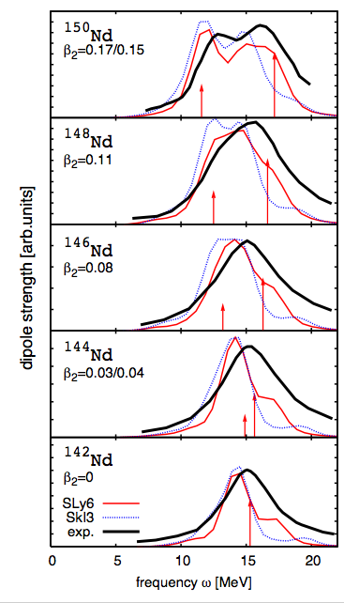
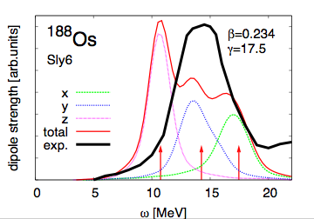
shape evolution
J. A. Maruhn, P.-G. Reinhard, P. D. Stevenson, J. Rikovska Stone and M. R. Strayer, Phys. Rev. C 71, 064328 (2005)

Slide 7
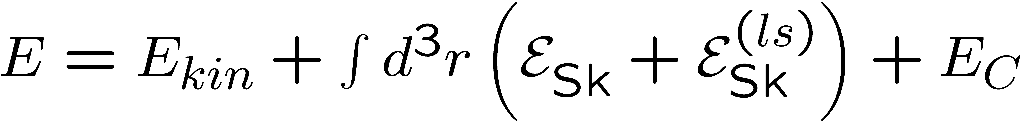
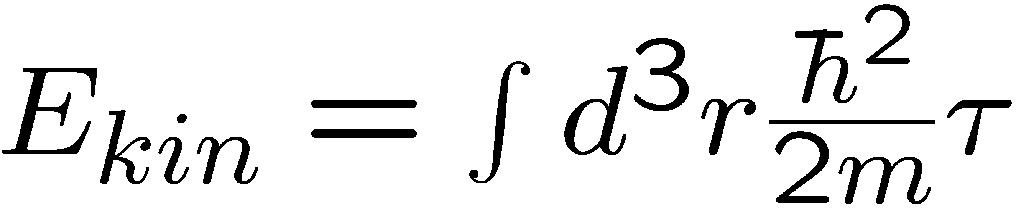
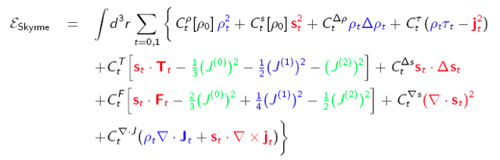
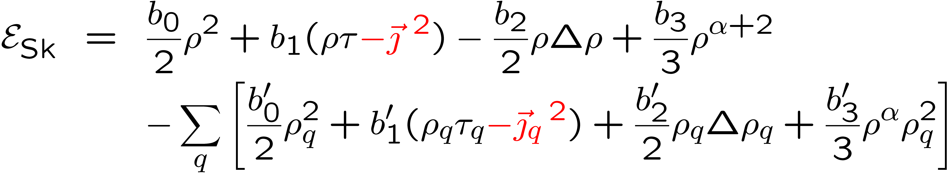
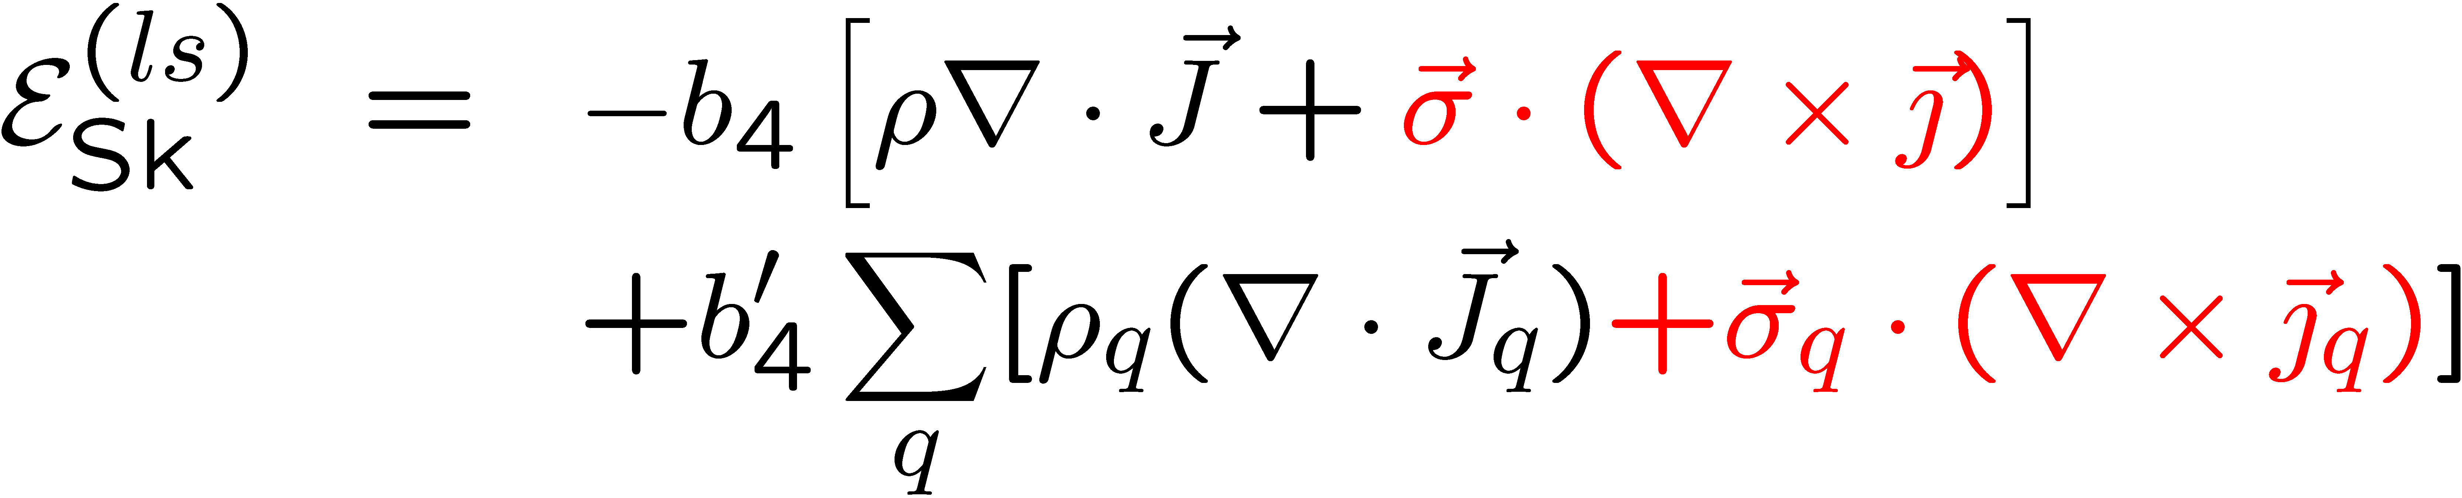
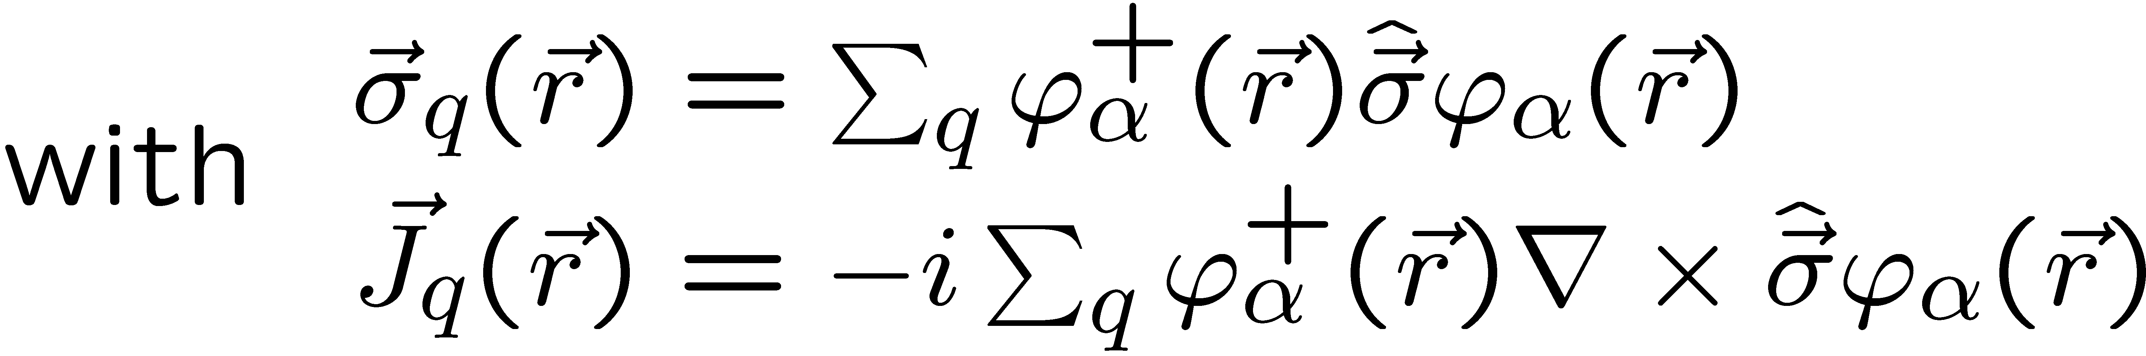
Skyrme Energy Functional

Slide 8
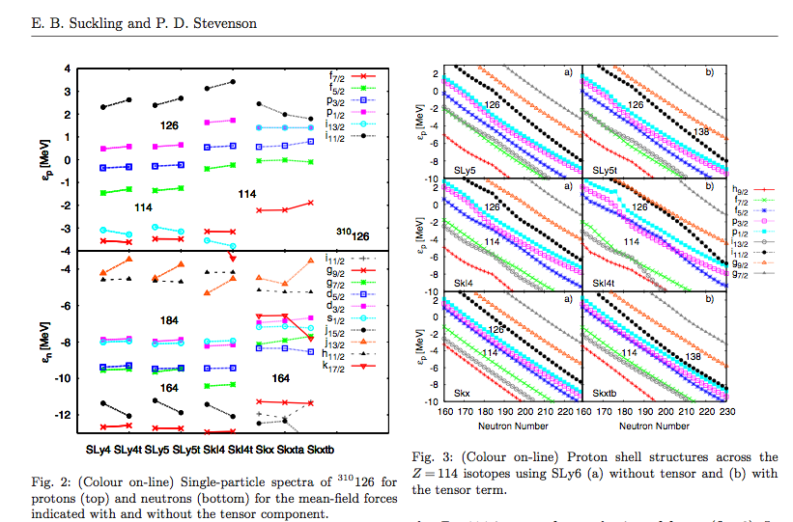
spectroscopy of heavy, neutron-rich isotopes
"The Effect of the Skyrme Tensor force on Superheavy Shell Closures", E. B. Suckling and P. D. Stevenson, EPL 90, 12001 (2010)
Notes:
Changing in shell structure and associated deformation critical for e.g. proton deformation studies.

Slide 9
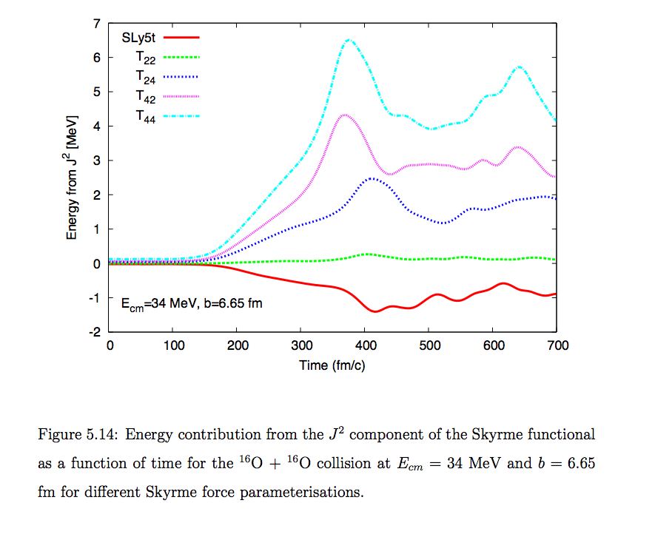
Tensor terms in collisions
E. B. Suckling, PhD thesis, 2011
Notes:
J = “tensor spin-current density’ = -i/2 (del_mu-del’_mu)S_nu|r’=r

Slide 10
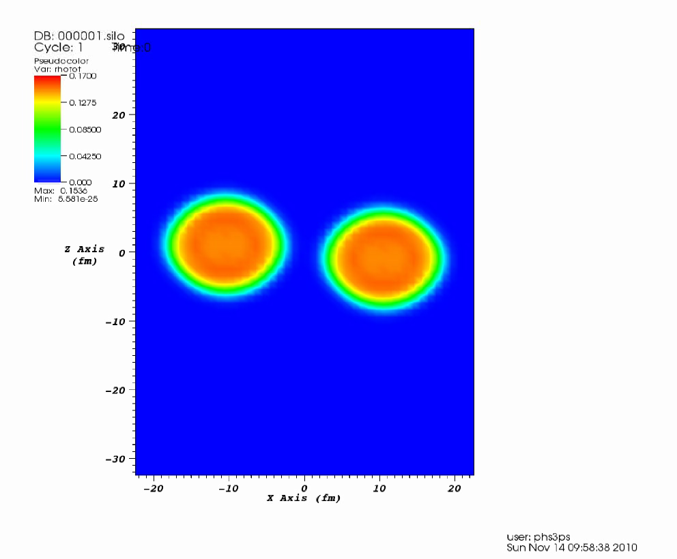
Notes:
A=107, Z=41 for central fragment (NB Alison’s talk: isomers around A=106, Z=40)

Slide 11
Acknowledgements
Thanks to my collaborators:
J. A. Maruhn, U. Frankfurt
S. Fracasso, U. Surrey
E. Suckling, U. Surrey
A. S. Umar, U. Vanderbilt
R. Rodriguez-Guzman, Madrid
J. R. Stone, ORNL

